Slide 1
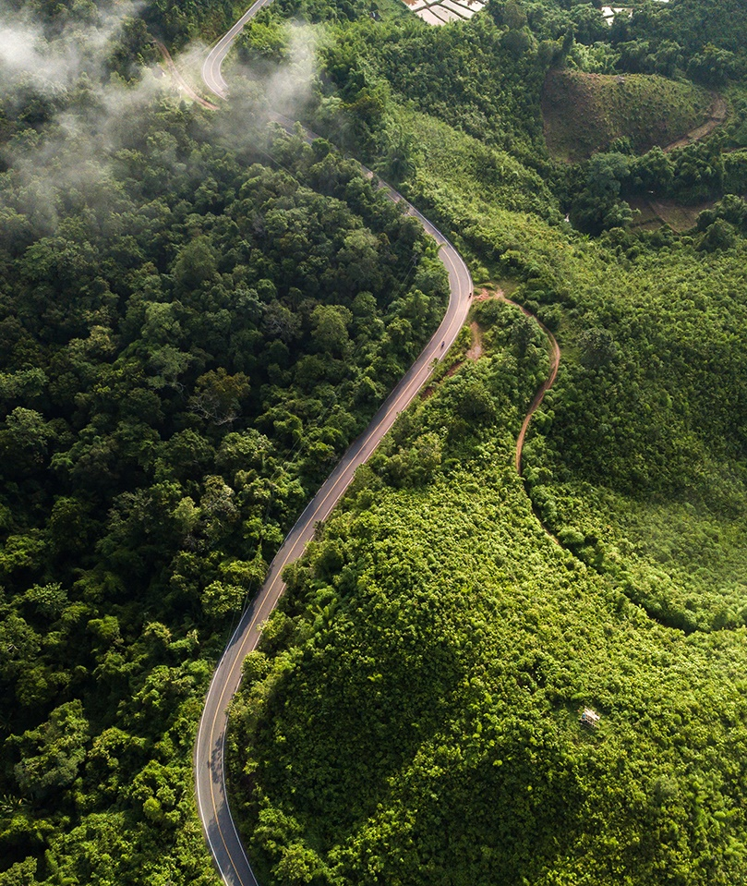
SHORT VERSION
Business Action Narrative
Short deck
This Business Action Narrative provides consistent messaging for talking about business action on nature to businesses.
This deck and its content have been produced by Business for Nature in collaboration with many partners.
Whenever using this deck or part of it, please acknowledge that the slides have been "adapted from Business for Nature“.

Slide 2
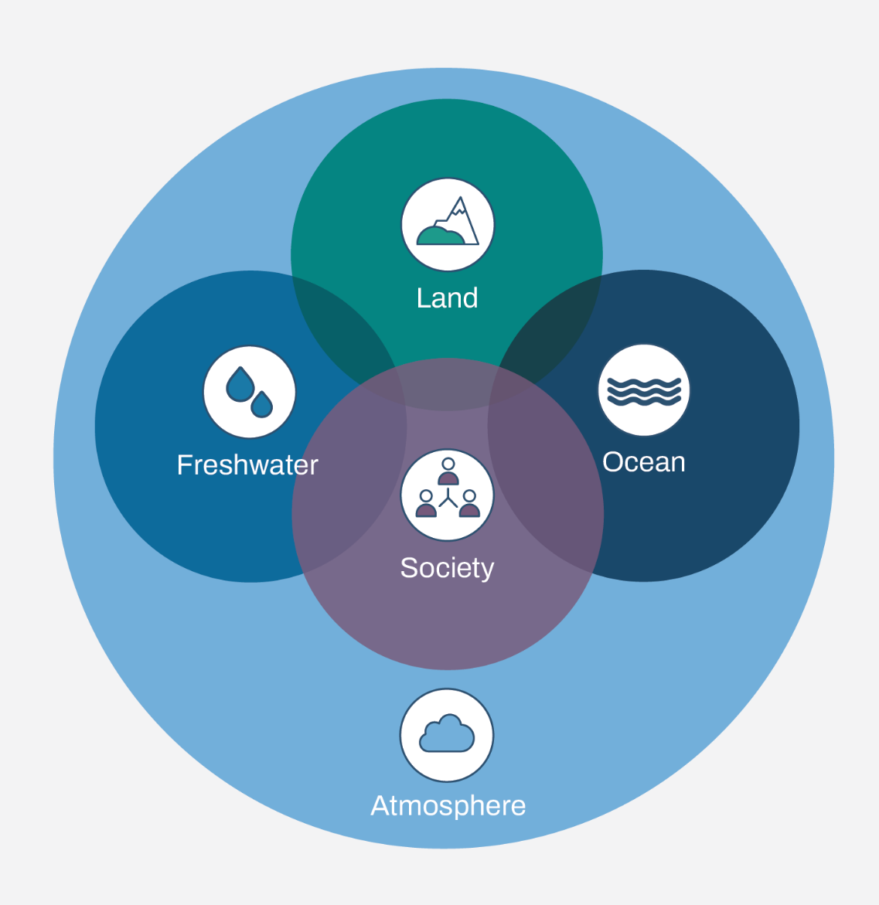
WHAT IS NATURE?
‘Nature’ is the natural world: all the natural capital, processes and natural phenomena that exist such as freshwater, air, the weather, oceans or forests. It also includes ecosystem services such as water filtration, pollination, climate regulation, carbon sequestration, erosion control and many others.
Nature can be understood through a construct of four realms upon which all life on earth depends: Freshwater, Land, Ocean and Atmosphere (TNFD).
Biodiversity is the diversity of all living things in nature – of ecosystems, between species and within species.
*Atmosphere includes climate
4 realms of nature (TNFD)
Ecosystem diversity Species diversity Genetic diversity
Source: IPBES, TNFD
Notes:
‘Nature’ refers to the natural world, with an emphasis on the diversity of living organisms (including people) and their interactions among themselves and with their environment.
Nature can be understood through a construct of four realms which are interconnected and interdependent. These are Land, Ocean, Freshwater and Atmosphere.
Biodiversity refers to the variety of living things in different environments, including diversity of ecosystems, between species and within species.
Think of environmental assets as nature’s capital – things like forests, wetlands and healthy soils. Flows are the benefits we receive from healthy environmental assets, this includes clean water filtration by wetlands, pollination of crops by bees and butterflies or flood protection by coastal forests.
Nature provides a wealth of benefits - it provides human development and equality, economic value and security, and increases our resilience to climate.
OPTIONAL ENGAGING QUESTION TO AUDIENCE TO EXPLORE DEPENDENCIES:
Define an ecosystem – A biological community of interacting organisms and their physical environment.
What did you have for dinner last night?
Do you know how many different ecosystems were involved in making your dinner? Try list as many as you can (e.g. salmon sushi – rice paddy, river, sea, etc).
The richness of ecosystems provides us with a wide variety of foods, all of which provide us with different nutrients and allow us to have balanced meals.

Slide 3
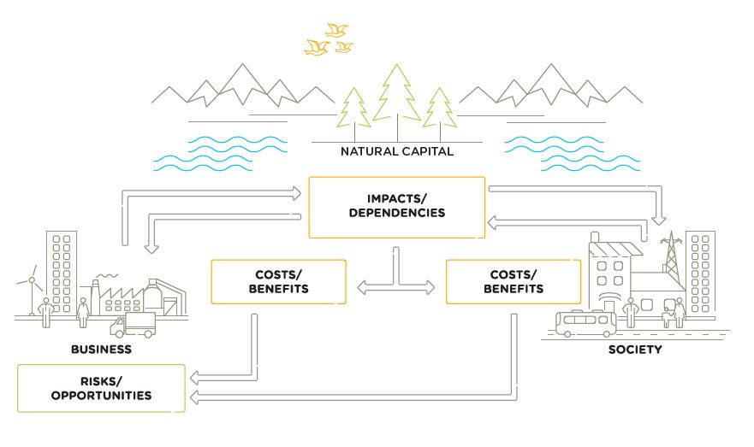
Interactions between business and natural capital
‘Natural Capital’ is the stock of renewable and non-renewable natural resources (e.g., plants, animals, air, water, soils, minerals) that combine to yield a flow of benefits to people.
Dependencies / Impacts /
Risks / Opportunities (DIROs)
Every business impacts and depends on natural capital to some degree and will experience risks and/or opportunities associated with those impacts and/or dependencies.
Source: CapitalsCoalition: Natural Capital Protocol
Notes:
On the previous slide we mentioned “Natural Capital”. This is a critical element in its interaction with businesses.
Natural Capital is defined as followed by Natural Capital Protocol – Capitals Coalition:
Natural Capital definition: The stock of renewable and non-renewable natural resources (e.g., plants, animals, air, water, soils, minerals) that combine to yield a flow of benefits to people (adapted from Atkinson and Pearce 1995, Jansson et al. 1994).
Natural resources encompass a range of materials occurring in nature that can be used for production and/or consumption. Renewable resources: These may be exploited indefinitely, provided the rate of exploitation does not exceed the rate of replacement, allowing stocks to rebuild (assuming no other significant disturbances). Renewable resources exploited faster than they can renew themselves may effectively become non-renewable, such as when over-harvesting drives species extinct (UN 1997). Non-renewable resources: These will not regenerate after exploitation within any useful time period. Non-renewable resources are sub-divided into reusable (e.g., most metals) and non-reusable (e.g., thermal coal).

Slide 4
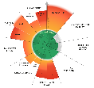
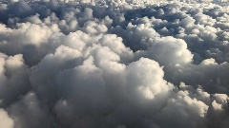
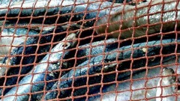
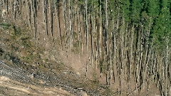
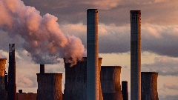
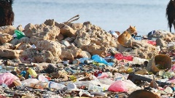
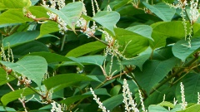
NATURE IS IN CRISIS, CREATING PHYSICAL RISKS FOR BUSINESS
Every business depends on nature…
…but also impacts nature loss…
…affecting our global economy.
The whole economy ultimately depends on nature and its services, with half of the world's GDP moderately or highly dependent.¹
And nature is particularly critical for stabilizing our climate, with over >50% of all GHG emissions absorbed by marine and land ecosystems.²
Businesses extract resources 1.75x faster than nature can replenish them.³
Our reliance on food, energy, infrastructure and fashion is behind more than 90% of man-made pressure on nature.⁴
This pressure manifests through the five main drivers of nature loss.⁵
The global economy is already operating outside the safe zone for six of the nine planetary boundaries.⁶
Up to $577 billion in annual global crop production is at risk from pollinator loss.⁷
Ecosystem degradation could lead to global GDP losses of up to $2.7 trillion annually in 2030.⁸
Freshwater
Raw materials
Healthy soils
Climate regulation
Pollination
And many more…
Direct exploitation
Land/Sea use change
Climate change
Pollution
Invasive non-native species
This creates physical risks: When businesses depend directly on nature for operations, supply-chain performance, real estate asset values, physical security and business continuity.
To business operations, assets or supply chains
e.g. access to water for cooling, production yield, climate stability
And you, what are your (physical) risks if you lost nature and its services for your operations, assets or supply chain?
Sources: 1 WEF; 2 UNEP; 3 The World Counts; 4 BCG; 5 IPBES; 6 Stockholm Resilience Centre; 7 BCG; 8 UNEP
Notes:
Every business depends on nature - half of the world's GDP (over $58 trillion) is moderately or highly dependent on nature and its services. This means that businesses rely on nature for a variety of things, including food, energy, and raw materials.
But, businesses are also impacting nature and contributing to nature loss.
Businesses are extracting resources 1.75x faster than nature can replenish them.
Food, energy, infrastructure and fashion are behind more than 90% of man-made pressure on nature.
This pressure manifests through the five drivers of nature loss: the exploitation of species, pollution, climate change, invasive non-native species and land/sea-use change.
Nature loss is affecting our global economy.
The global economy is already operating outside the safe zone for six of the nine planetary boundaries.
Up to $577 billion in annual global crop production is at risk from pollinator loss.
Ecosystem degradation could lead to global GDP losses of up to $2.7 trillion annually in 2030.
This creates physical risks to businesses. Physical risks are the results of direct dependencies on nature. For example, for businesses that depend on freshwater resources, a lack of access to freshwater could disrupt economic activities. And, businesses that rely on pollinators for their crops could see their yields decline if pollinator populations continue to decline.
And you, what are your (physical) risks if you lost nature and its services for your operations, assets or supply chain?

Slide 5
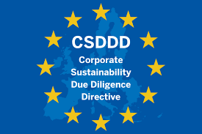
BUSINESSES FACE PRESSURE TO ADDRESS THESE PHYSICAL RISKS
Global agenda
The Biodiversity Plan (GBF)¹
Regulatory pressure
Investor expectations
Consumer & peer pressure
196 governments agreed to halt and reverse nature loss by 2030 in December 2022.
GBF Target 15 explicitly commits governments to require all large companies and financial institutions to assess and disclose their risks, impacts and dependencies on nature.
Targets are now being translated to National Biodiversity Strategies & Action Plans.
The Corporate Sustainability Reporting Directive (CSRD) requires companies to disclose information on their nature and biodiversity impacts.
The Corporate Sustainability Due Diligence Directive (CSDDD) expects companies to identify, prevent, mitigate and end environmental and human harms and within their value chains.
163 financial institutions with €21.7 trillion AUM have signed the Finance for Biodiversity pledge, committing to protect and restore biodiversity through their finance activities and investments.²
Nature Action 100 leverages investor influence to drive greater action on nature in key sectors.
Four out of five consumers say they’re willing to pay a premium for sustainably made products.³
Over 400 companies from 50 countries have agreed to become ‘Early Adopters’ for the TNFD.⁴
The Science Based Targets Network (SBTN) has developed guidance for companies to set robust nature targets.
The above pressures create transition risks: When the direct and indirect impacts of business activities on nature trigger negative business consequences, such as losing customers or entire markets, costly legal action and adverse regulatory changes.
Legal and policy risks
Market risks
Technology risks
Reputational risks
Source: 1 CBD; 2 Finance for Biodiversity; 3 PwC; 4 TNFD
Notes:
In recognition of these economic risks, businesses are facing pressure to address their impacts and dependencies on nature. This pressure stems predominantly from 4 different sides.
Global Biodiversity Framework
196 Governments have agreed to halt and reverse nature loss by 2030 in December 2022.
Historic moment, first time governments stated so explicitly what they expect from businesses on nature. GBF Target 15 explicitly calls for mandatory assessment and disclosure, and to reduce business negative impacts on nature.
What does this mean? Targets are now being translated to National Biodiversity Strategies & Action Plans. Businesses can expect more regulation.
Regulatory pressure
In parallel, some regulations are already emerging. For example…
The Corporate Sustainability Reporting Directive (CSRD) requires companies to disclose information on their nature and biodiversity impacts.²
The Corporate Sustainability Due Diligence Directive (CSDDD) expects companies to identify, prevent, mitigate and end environmental and human harms and within their value chains.
Investors are also demanding change… Some of you may have already received questions from investors from plastics, freshwater, pollution and more.
Finally, businesses face pressure from consumers and peers.
Recent studies show 85% consumers indicate that they have shifted their purchase behavior to be more sustainable in the past five years.
There is also increasing guidance available for companies to act– which we’ll touch on later – and this means businesses face pressure to keep up with their peers.
Already 416 companies from 50 countries have agreed to become ‘early adopter’ of the Taskforce on Nature-related Financial Disclosures and this number is likely to increase.
All these factors create transition risks for businesses – the direct and indirect impacts of business activities on nature trigger negative business consequences, such as losing customers or entire markets, costly legal action and adverse regulatory changes.

Slide 6
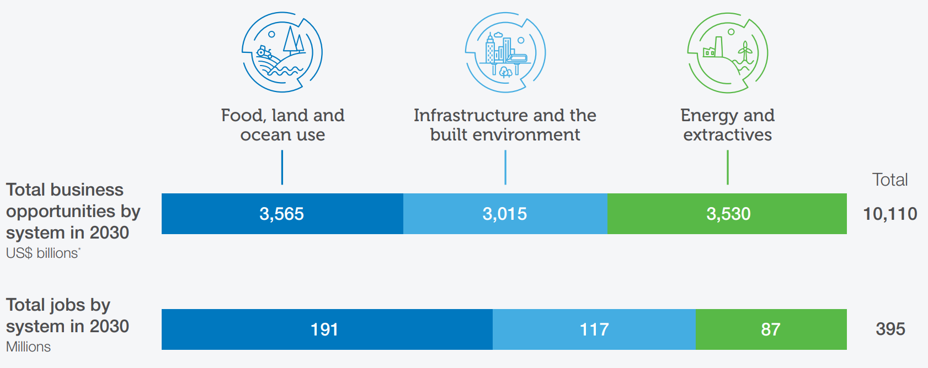
BUT A NATURE-POSITIVE TRANSITION BRINGS OPPORTUNITIES
Transitions in just three socio-economic systems could deliver $10.1 trillion of annual business opportunities and 395 million jobs by 2030.
New Nature Economy Report II: The Future of Nature and Business
Mitigate risks
Non-compliance
Unmet stakeholder expectations
Lack of resilience
Generate revenue
New markets and products
Enhanced reputation
Reduce costs
Resource efficiency
Lower cost of capital
Notes:
However, a nature-positive transition does also bring opportunities.
The WEF has estimated that transitions to nature-positive in just three socio-economic systems could deliver $10.1 trillion of annual business opportunities and 395 million jobs by 2030. https://www.weforum.org/press/2020/07/395-million-new-jobs-by-2030-if-businesses-prioritize-nature-says-world-economic-forum/
Beyond these opportunities to generate revenue, there is also an opportunity to reduce costs, worth nearly $700 billion annually. https://www.mckinsey.com/capabilities/sustainability/our-insights/nature-in-the-balance-what-companies-can-do-to-restore-natural-capital#/
For example, through resource efficiency and by accessing new capital, markets and investment opportunities through improved investor trust.
Finally, behind every risk lies the opportunity to appropriately mitigate the risk, nature-positive transitions can reduce risks of non-compliance, unmet stakeholder expectations and lack of resilience.

Slide 7
BUT A NATURE-POSITIVE TRANSITION BRINGS OPPORTUNITIES
Generate revenue
$10 trillion by 2030¹
New markets and products: Business opportunities brought by shifting to nature-positive models.
Enhanced reputation: Increased brand value and recognition through positive contributions to nature.
For both public and private companies, there is a strong positive correlation between good ESG performance and return on sales growth.²
Unilever aims to generate €1.2 billion revenue in plant-based foods within 5-7 years.³
Reduce costs
$700 billion annually⁴
Resource efficiency: Buy less products and materials, optimize processes (e.g. water use reduction).
Lower cost of capital: Access to new capital, markets and investment opportunities through improved investor trust.
Reduce producer taxes (e.g. EPR) with more circular models; e.g. plastic tax is £200/tonne in the UK and €450/tonne in Spain and Italy.⁵
AXA has committed $350 million to activities that create nature-positive outcomes, facilitating access to capital.⁶
Mitigate risks
Compliance with upcoming and future regulations could help prevent high costs in fines and legal fees.
Anticipating stakeholder expectations could lead to strong market position and enterprise value.
Strong resilience and awareness of dependency on weakening ecosystem services could help companies prevent and mitigate risks.
Land degradation costs the world $6-10 trillion every year.⁷
New EU legislation (CSDDD) could lead to fines of at least 5% of a company's net worldwide turnover if they don't comply.⁸
Source: 1 WEF; 2 D&B; 3 Unilever; 4 McKinsey; 5 EY; 6 AXA; 7 Science Direct; 8 EU CSDDD.
Notes:
However, a nature-positive transition does also bring opportunities.
Opportunities to generate revenue, for example by shifting to nature-positive models – this is considered worth $10 trillion by 2030.
For example, Unilever aims to generate €1.2 billion revenue in plant-based foods within 5-7 years
There is also an opportunity to reduce costs, worth nearly $700 billion annually.
For example, through resource efficiency and by accessing new capital, markets and investment opportunities through improved investor trust.
Finally, behind every risk lies the opportunity to appropriately mitigate the risk, nature-positive transitions can reduce risks of non-compliance, help meet stakeholder expectations and strenghten the resilience of the business.

Slide 8
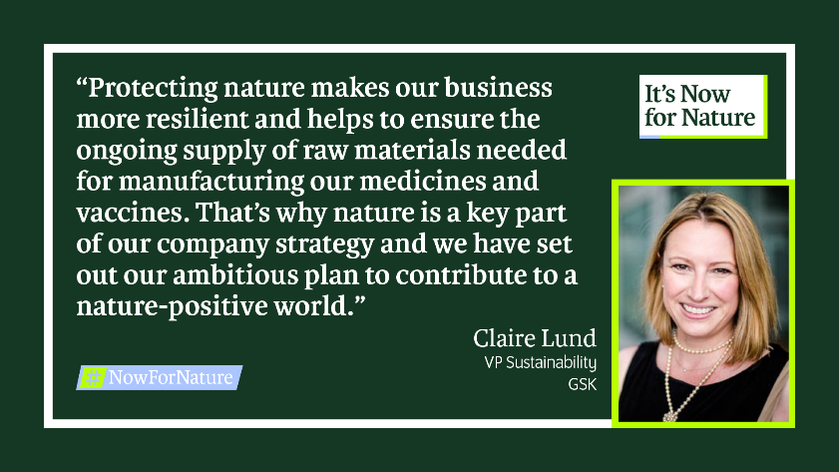
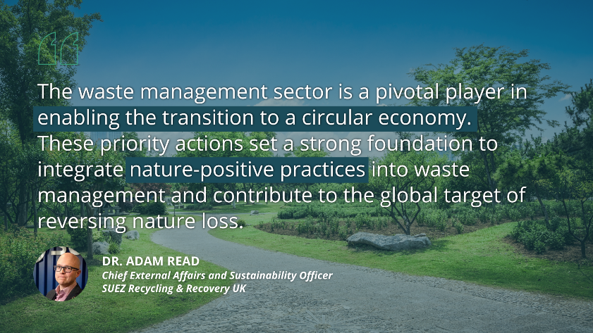
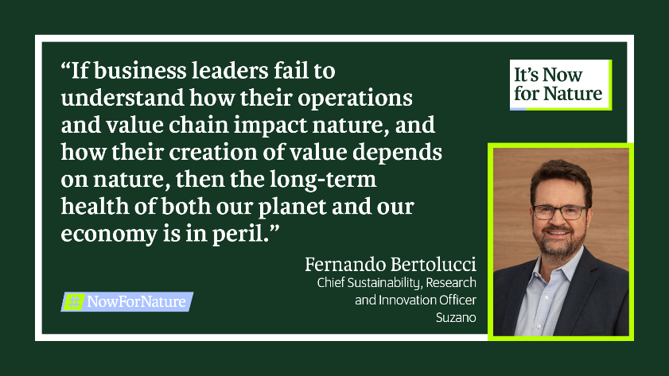
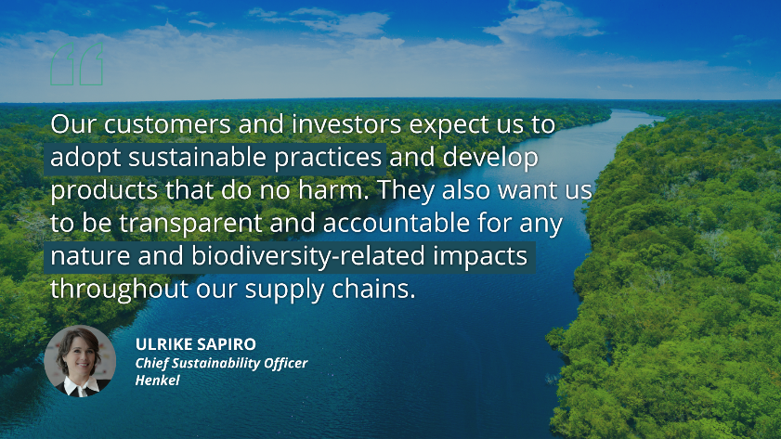
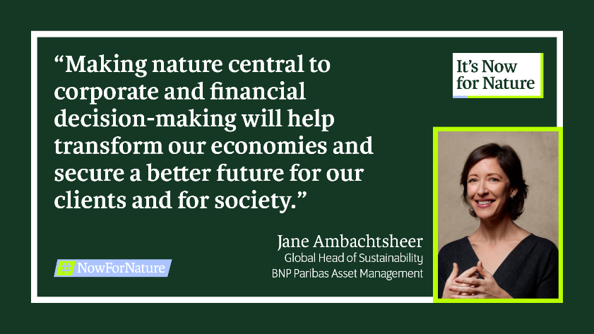
Leaders are uniting with a consistent message
And many others…
Notes:
The presenter can choose which cards to use, many more than those 6 are available on the next slide.

Slide 9
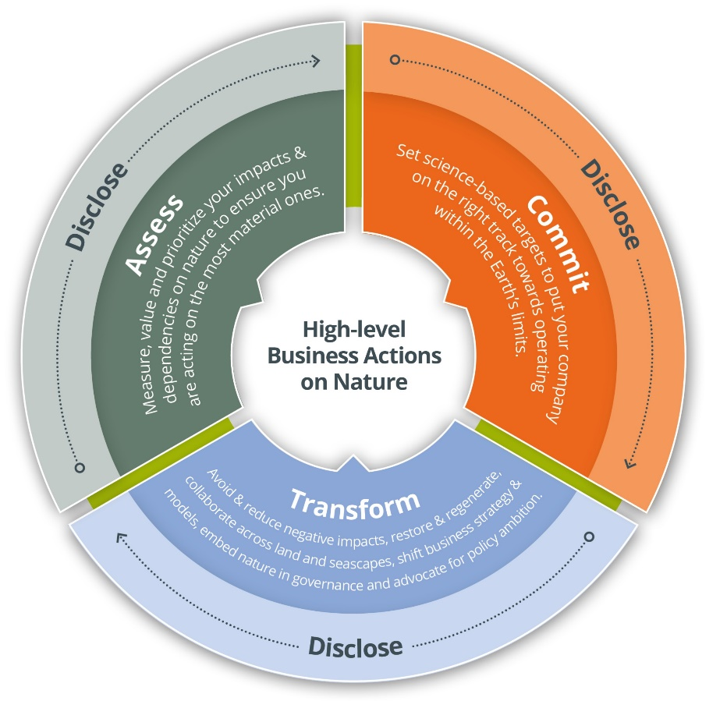
BUSINESSES CAN USE ACT-D (HIGH-LEVEL ACTIONS ON NATURE)
To coordinate business efforts and to have a consistent approach to accelerate nature action, leading organizations developed the high-level business actions on nature, known as the ACT-D
ASSESS: Measure, value and prioritize your impacts and dependencies to ensure you are acting on the most material ones.
COMMIT: Set transparent, time-bound, specific, science-based targets to put your company on the right track towards operating within the Earth’s limits
TRANSFORM: Contribute to systems transformation by avoiding and reducing negative impacts, restoring, and regenerating, collaborating across land, seascapes and river basins, shifting business strategy and models, advocating for policy ambition and embedding your strategy within your corporate governance
DISCLOSE: Publicly report material nature-related information throughout your journey
Available at: www.businessfornature.org/high-level-business-actions-on-nature
Supported by and aligned with:
and more…
Notes:
To coordinate business efforts and to have a consistent approach to accelerate nature action, leading organizations developed the high-level business actions on nature, also known as ACT-D
The first action is to assess: Measure, value and prioritize your impacts and dependencies to ensure you are acting on the most material ones. Companies might use the guidance of the TNFD to understand how to conduct this assessment.
Businesses also need to commit by setting transparent, time-bound, specific, science-based targets to put their company on the right track towards operating within the Earth’s limits. The science-based targets network has developed guidance to support companies in setting targets on nature.
But action on nature is not just about measuring and setting targets, ultimately, companies need to transform – they need to contribute to systems transformation by avoiding and reducing negative impacts, restoring, and regenerating, collaboration across land, seascapes and river basins, shifting business strategy and models, advocating for policy ambition and embedding your strategy within your corporate governance.
And finally, disclose. Companies need to publicly report material nature-related information throughout their journey.

Slide 10
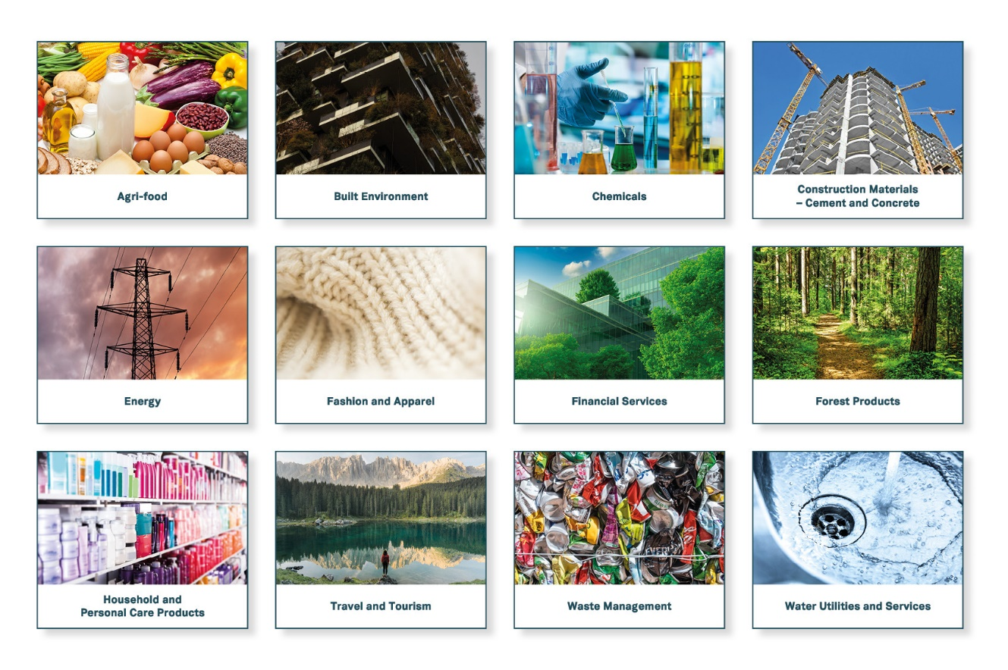
START BY UNDERSTANDING YOUR RELATIONSHIP WITH NATURE
Use the sector actions towards a nature-positive future to build an understanding of how businesses across 12 different sectors of the economy interact with nature and can take action.
The 12 sector specific overviews include:
The main impacts of the sector on nature
The main dependencies of the sector on nature
The priority actions businesses can take
A collaboration between:
World
Economic
Forum
Available at: www.businessfornature.org/sector-actions
Sectors included in September ‘23 launch: Buildings and infrastructure; chemicals; construction materials; energy systems; fashion and apparel; finance; food and agriculture; forest products; household and personal products; tourism; waste management; water utilities and services.
Notes:
For companies beginning their journey, Business for Nature, along with the World Economic Forum and World Business Council for Sustainable Development have developed ‘Sector Actions towards a Nature Positive Future’ – this highlights, for 12 key industry sectors – what are the key impacts and dependencies of the sector on nature and what are the priority actions businesses should take to contribute to a nature-positive future? This will be really useful to understand your business’ interface with nature and where your key action areas might be.

Slide 11
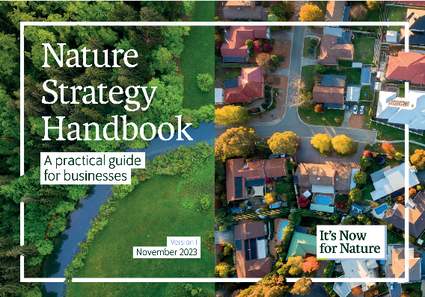
WHERE IS NATURE IN YOUR BUSINESS STRATEGY?
It’s Now for Nature is a joint global campaign to bring together all businesses to act on nature and contribute towards a nature-positive world by 2030.
Call to action for businesses
How to get started
Develop and publish a credible nature strategy building on existing tools and frameworks to scale and speed up action.
To join the campaign and have their nature strategy published on the website, companies can submit their nature strategy on the Now for Nature website
Use the Nature Strategy Handbook which provides an overview of the key components of a credible nature strategy, and signposts to suggested resources and frameworks.
Available in multiple languages.
Benefits
for businesses
Join a growing community of businesses committed to scaling and speeding business action on nature
Ensure your strategy is on the right track to contribute to halting and reversing nature loss by 2030
Strengthen the legitimacy, visibility and accountability of your actions both internally and externally
Notes:
Companies that have followed the high-level actions and understand their interface with nature will be ready to develop a nature strategy to show how they consider and integrate nature in their decision-making to transform their operations and supply chains.
Business for Nature coalition launched a global business action campaign called ‘It’s Now for Nature’ to bring all businesses to act on nature and contribute towards a nature-positive world by 2030.
This is a long-term campaign running until 2030. As a first step, we are asking businesses to develop a board or C-suite approved nature strategy and submit their strategy to the campaign through the campaign website.
To support companies in this process, we have developed a Nature Strategy Handbook. The handbook builds on ACT-D by guiding businesses to use the actions to create a nature strategy. There are many frameworks that help you along specific steps of ACT-D and together, these can help you build a comprehensive nature strategy. In the Nature Handbook, we have provided a high-level overview of the key components of a credible nature strategy, and have referred to the TNFD, SBTN and other frameworks to provide detailed guidance on meeting each of these components
Companies who join the campaign will benefit from
Joining a growing community of businesses committed to scaling and speeding business action on nature.
Ensuring their nature strategy is on the right track to contribute to halting and reversing nature loss by 2030
Strengthening the legitimacy, visibility and accountability of actions both internally and externally.

Slide 12
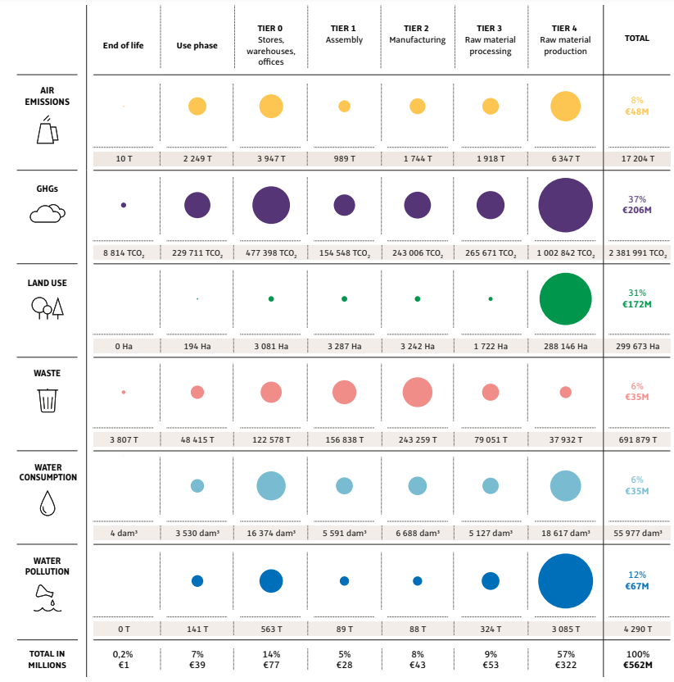
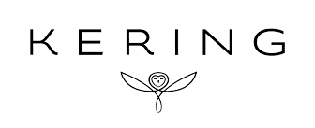
Assess | Commit | Transform | Disclose
Assess: In Practice
Materiality Assessment Example: Kering
Using this table, Kering clearly show what they've assessed to be their largest environmental impacts.
Tier 4, the raw material production phase, is where their greatest environmental impacts occur.
Resources: refer to Business for Nature ACT-D for more information (SBTN, TNFD’s LEAP process, ENCORE and more)

Slide 13
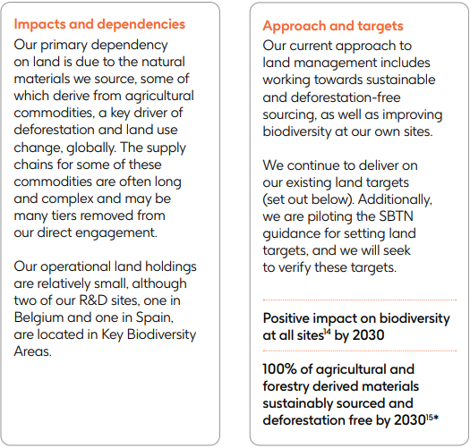
Commit: In Practice
Assess | Commit | Transform | Disclose
SMART Targets example: GSK
GSK’s targets are broken down by their four focus areas:
Freshwater
Land
Oceans
Atmosphere
Their land targets correlate to their primary impacts and dependencies and one of them is linked with the remuneration of their senior leaders.
Resources: align goals with The Biodiversity Plan, leverage SBTN’s technical guidance and the Science Based Targets initiative (SBTi)

Slide 14
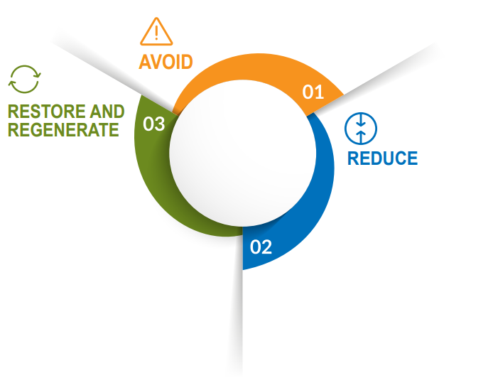
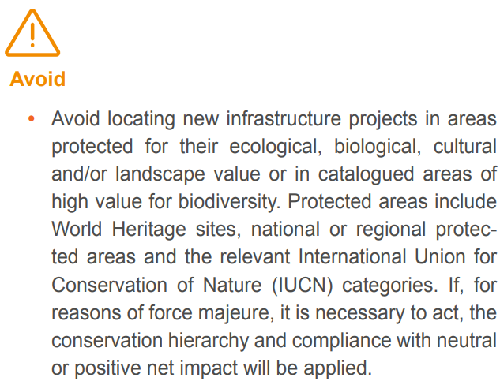
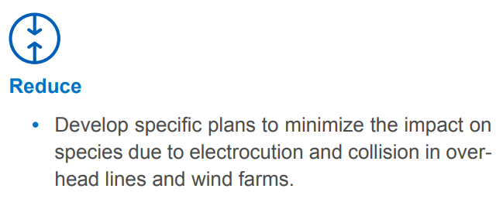
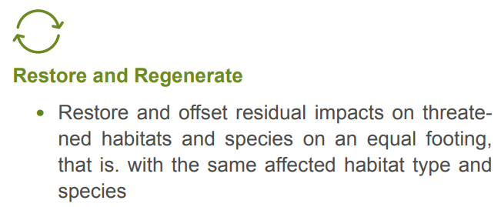
Transform: In practice
Assess | Commit | Transform | Disclose
Mitigation hierarchy application example: Iberdrola
Iberdrola have applied the mitigation hierarchy in setting out their transformative actions.
This is alongside broader value chain and governance actions.
Resources: The Action Framework (AR3T hierarchy), NBS benefits explorer, IUCN Global Standard for Nature-based Solutions, WBCSD’s Roadmap to Nature Positive and Sector Actions developed by BfN, WEF and WBCSD

Slide 15
KEY QUESTIONS TO GET STARTED
Do you know how your operations & supply chain interface with nature? E.g. operating in water-stressed regions?
What is your plan to get the buy-in from your board to develop a credible nature strategy?
Do you know what actions your investors are expecting you to take on nature?
Do you know how your climate strategy interfaces with nature and where synergies and trade-offs may exist?

