Slide 1
Identifying and analyzing stakeholders of ecosystem services
J Lascurain
info@sgm.es
23 February 2017

Slide 2
Overview
Why include stakeholders in ecosystem services?
How to identify and analyze key stakeholders

Slide 3
Purpose
The purpose of this slideshow is to illustrate a process for identifying stakeholders in an ecosystem services (ES) study, based on experience in the OPERAs Barcelona dunes exemplar case study.

Slide 4
Why stakeholders?
Because ES are about human-nature interface, it is essential to know what happens on the “human” side.
Good stakeholder knowledge and engagement is a key factor for trustworthy and efficient governance of ES, and can contribute to better ecosystem management.

Slide 5
Who are stakeholders?
Stakeholder: any group, organization or individual who can affect or is affected by the ecosystem’s services.
Definition developed by OpenNESS
OpenNESS Glossary http://www.oppla.eu/product/29

Slide 6
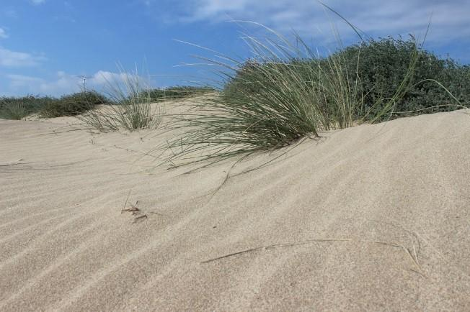
Introducing Barcelona OPERAs Case Study
Objective:
To learn to construct and maintain dunes on urban beaches to optimize the flows of ecosystem services such as protection against sea level rise, and to learn how to shape social attitudes to make intensive recreational use of beaches compatible with the protection of the dunes.

Slide 7
2 steps to identify and analyze key stakeholders
Identify individual stakeholder characteristics
See how stakeholders interact

Slide 8
2 steps to identify and analyze key stakeholders
Identify individual stakeholder characteristics
See how stakeholders interact

Slide 9
1. Identify individual stakeholder characteristics
First identify individual stakeholder characteristics
It can be quite open:
Level of system knowledge
Level of dependence/interest
Quantity
Environmental impact
Spatial & temporal distribution
Role (e.g., administration, NGO, …)

Slide 10
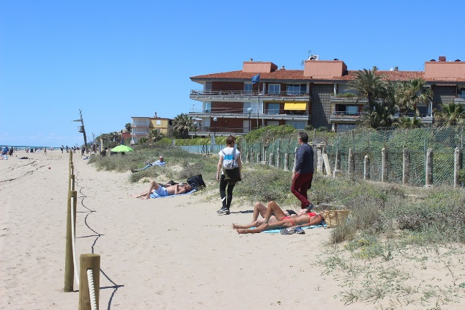
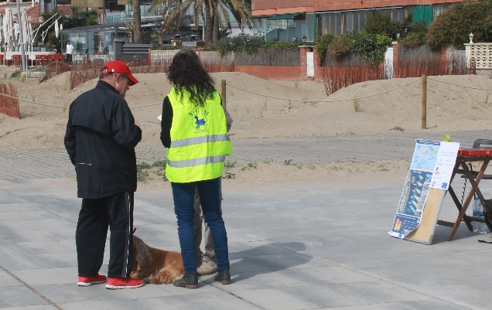
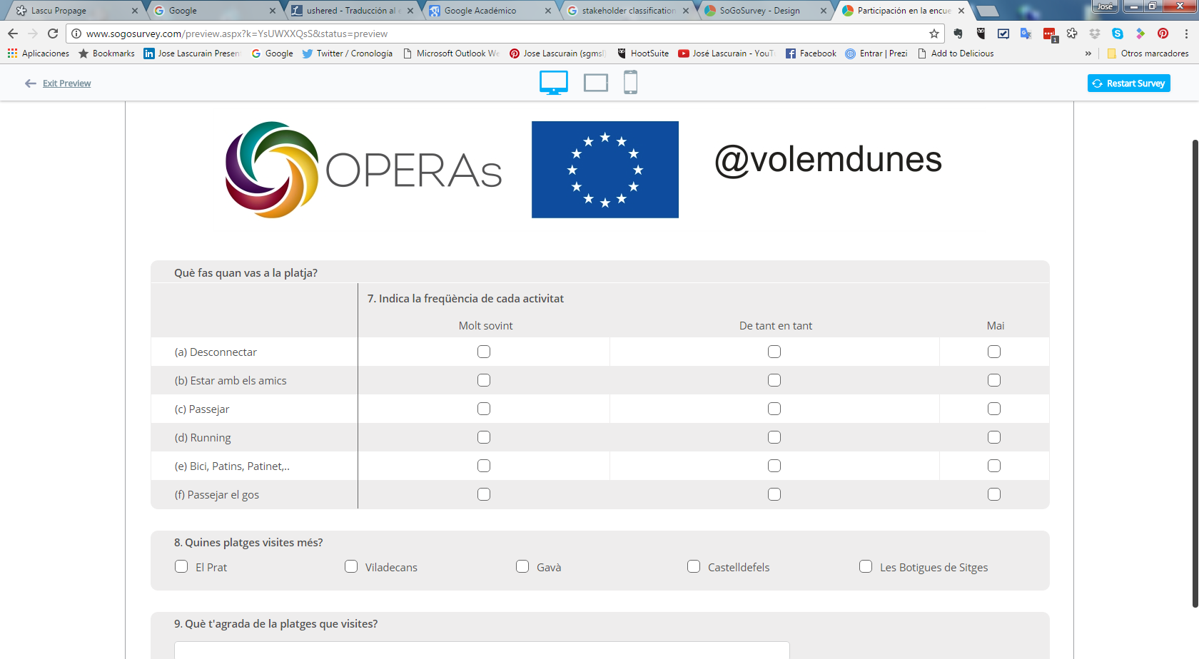
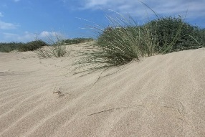
Selected methods to identify stakeholders and their interests in Barcelona
Fieldwork: make observations to discover what people do.
Interviews: Discover motivations.
Online surveys: cost efficient, but need to check representativeness of the population that fills the surveys.

Slide 11
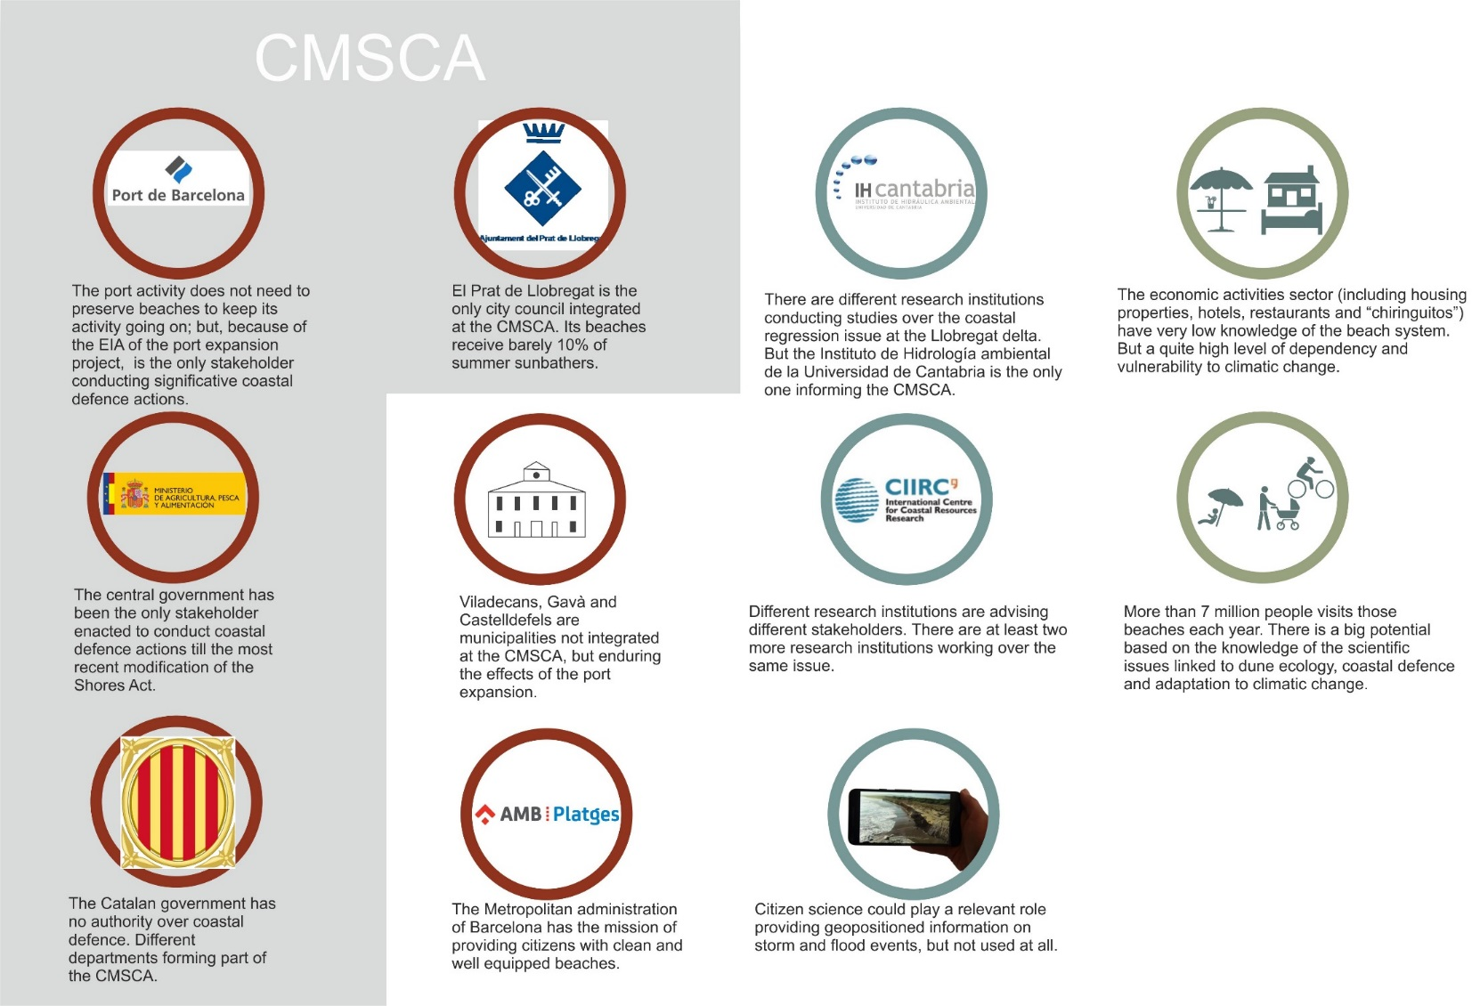
Characterizing stakeholders in Barcelona

Slide 12
Different stakeholders have different characteristics

Slide 13

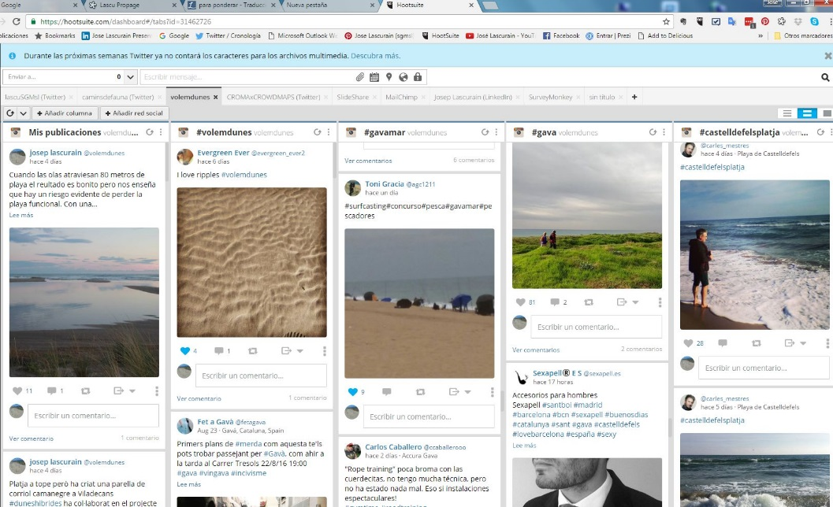
Using social media to analyze stakeholder interests
Social media listening helped to discover what people like from beaches and its variability with time and among different beaches.

Slide 14
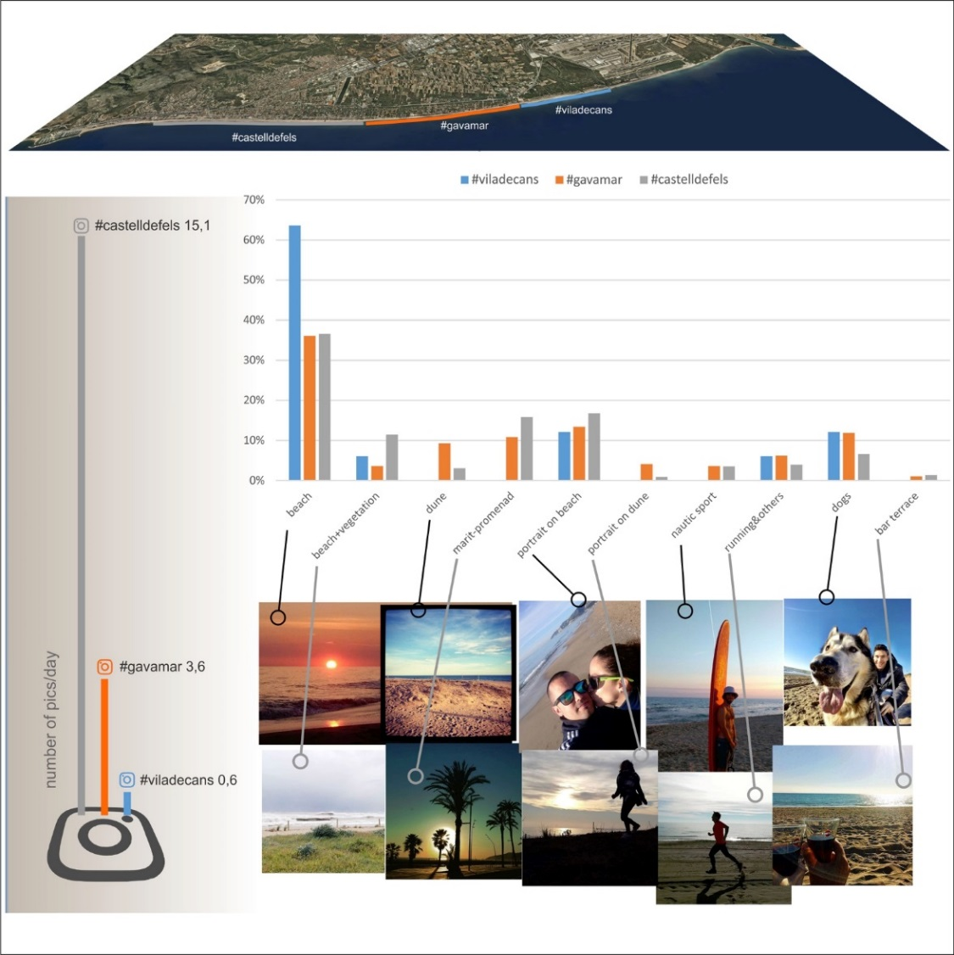
Barcelona results of social listening
An analysis on Instagram by #hashstags shows how different stakeholders at different parts of the beach enjoy different ecosystem benefits

Slide 15
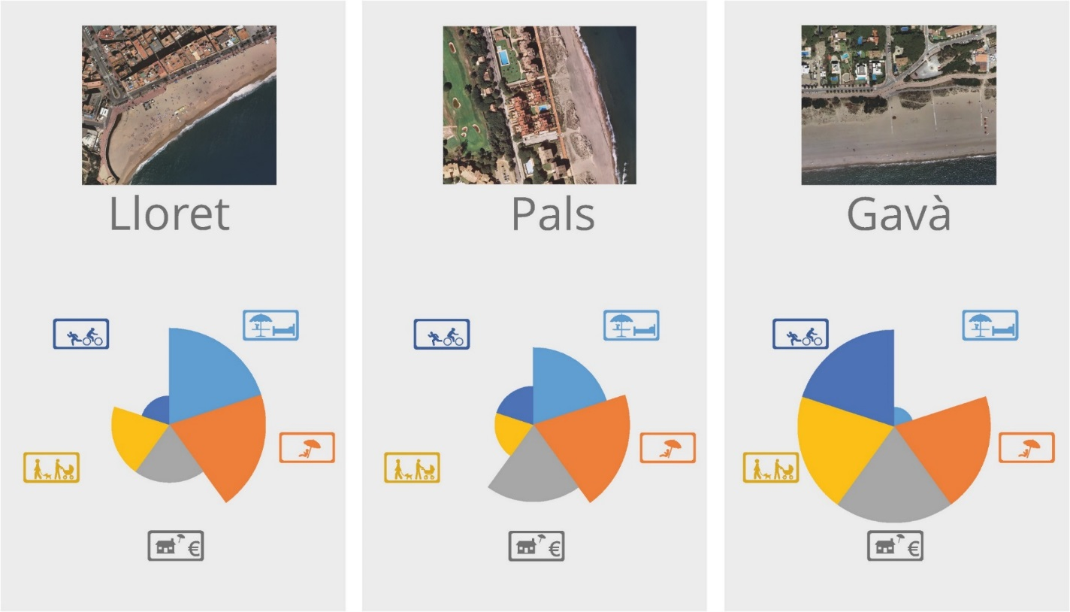
Some examples from OPERAs Barcelona dunes exemplar case study
Socio cultural valuation can be an efficient method to classify beaches at a bigger scale.

Slide 16
2 steps to identify and analyze key stakeholders
Identify individual stakeholder characteristics
See how stakeholders interact

Slide 17
2. See how stakeholders interact
Once identified, see how stakeholders interact.

Slide 18
Analyze relationships between stakeholders
The level of centrality will help identifying key stakeholders.
Some stakeholders are essential to sustain the network.
If the bold nodes disappeared, links would be lost.

Slide 19
Analyze how stakeholders influence each other
Sometimes this influence capacity is just a regulatory flow, while in others is social pressure

Slide 20
Findings from Barcelona Dunes
The capacity to influence or exert social pressure.
Local press media is a big influencer.
Municipalities can have a big influence on metropolitan administrations.
Stakeholder networks and associations can be big influencers.

Slide 21
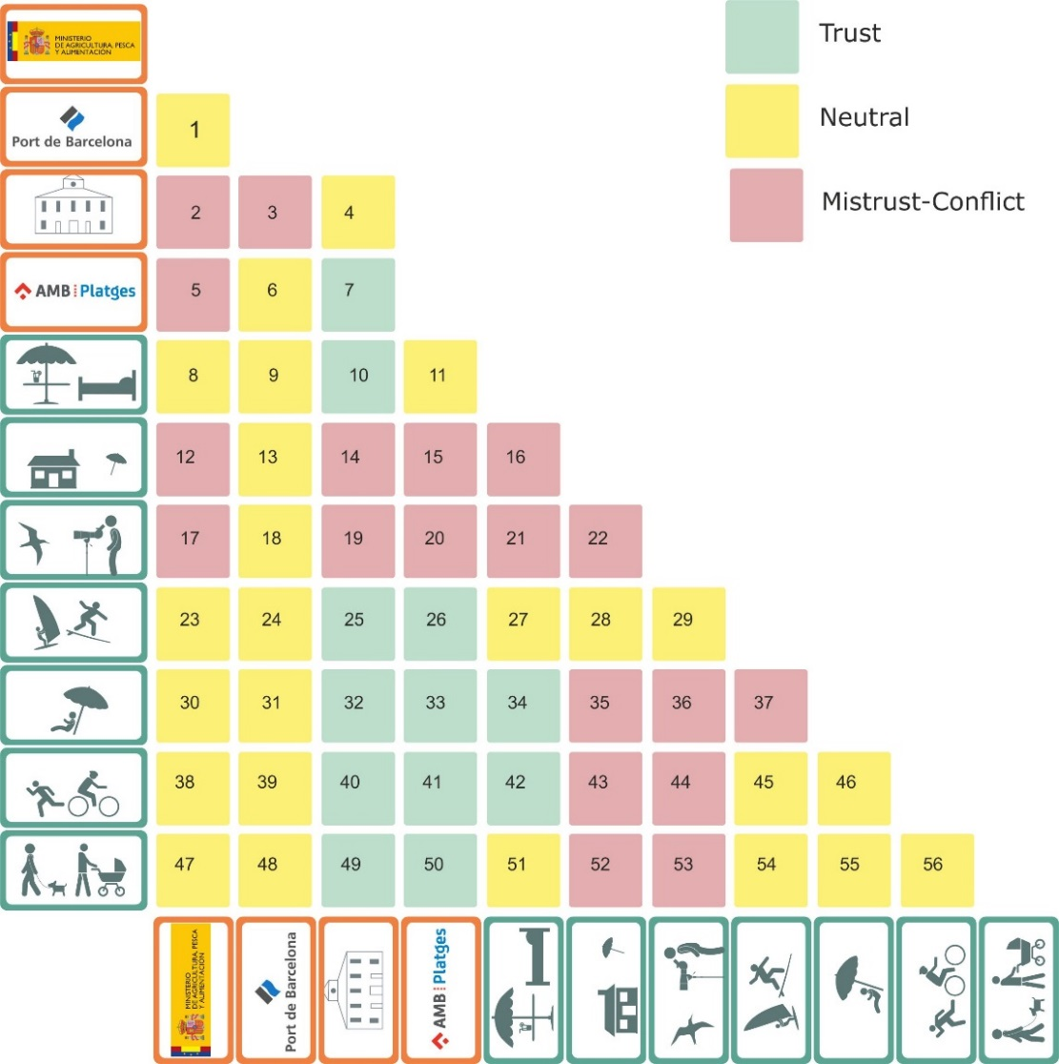
Identifying stakeholder interaction in Barcelona
We found that had a high level of trust from beach users, but not from birdwatchers. And local residents are not happy with the crowds of sunbathers at summer.

Slide 22
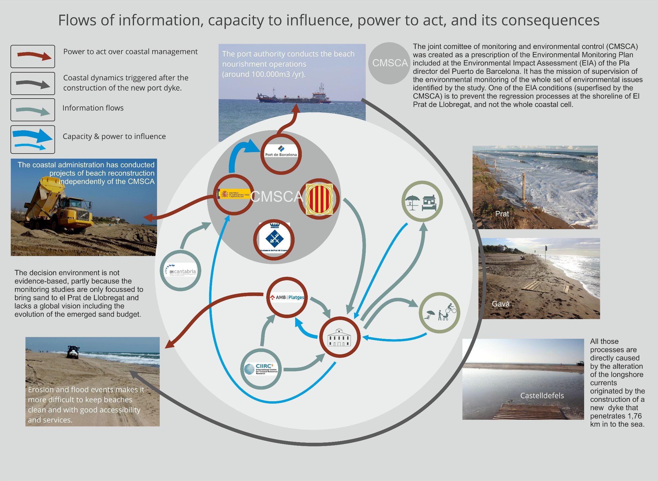

Slide 23
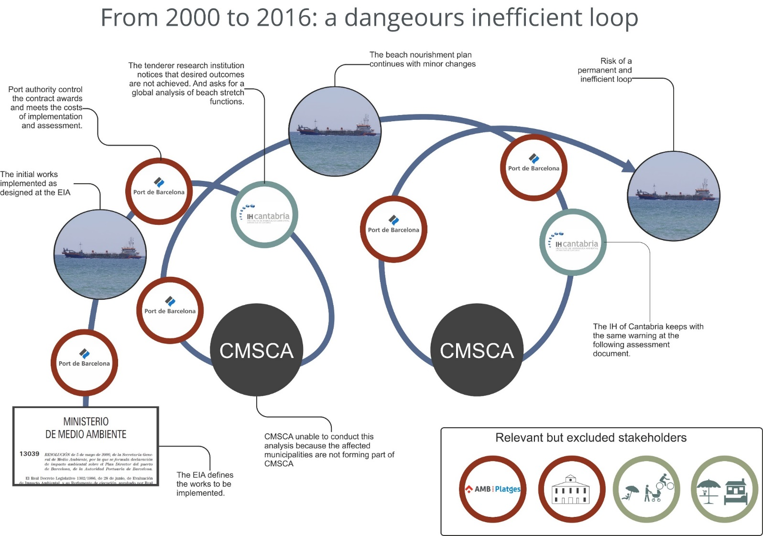
Some examples from OPERAs Barcelona dunes exemplar case study
Decision making schemes that did not include all relevant stakeholders leads to inefficient management

Slide 24
